Slide 1

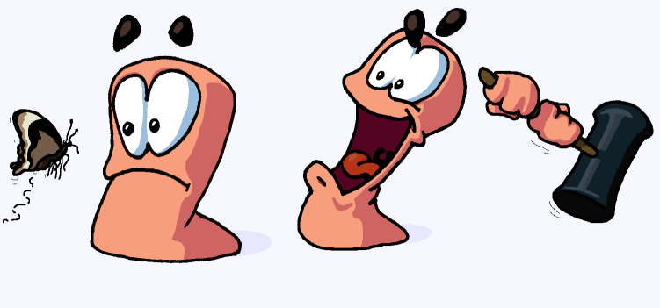
Team 4
Squires: Knights in the Making
By:
Alex Ogilbee
Joseph Hill
Fernando Trevino

Slide 2

First Playable
Map generation
Framework of terrain in place
No environment hazards
Core Weapons Implemented
Missile, Rifle, Grenade, Melee
AI can move and shoot
Working Game State
Match will play from start to finish
Rudimentary Weapon Swap
Destructible Terrain

Slide 3
Challenges

Slide 4
Goals for Testing Day 11/18
Environmental Hazards
Improve map generation
More weapons of each type implemented
Sounds
Background Music for each map theme
Weapons
Player death
Improved AI Player shooting and movement

Slide 5
Demo

